Slide 1
Top 30 companies Americans want to work for

Slide 2
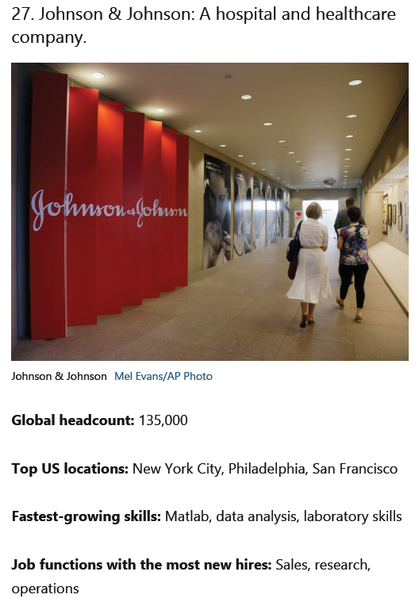
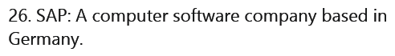
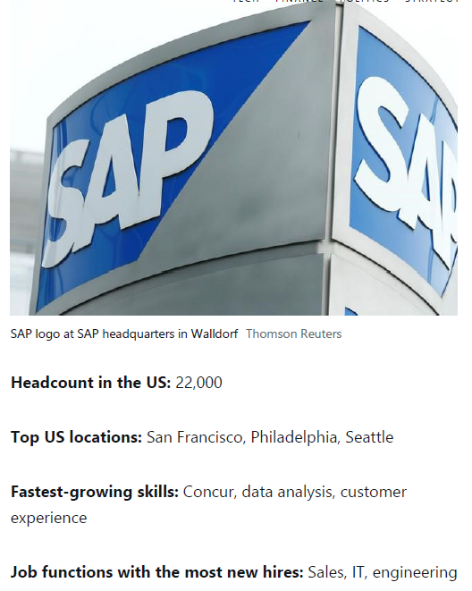

Slide 3
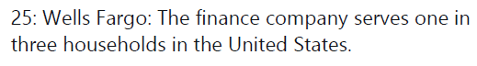
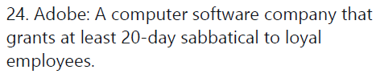
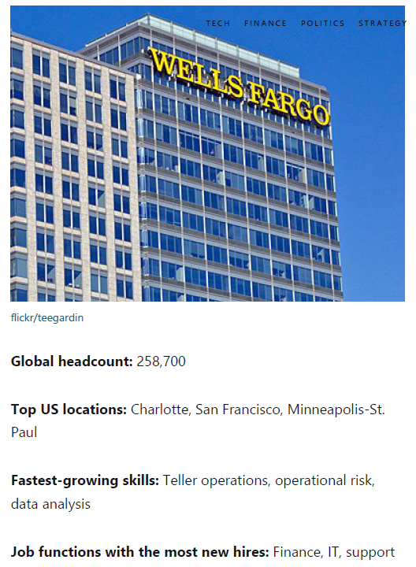
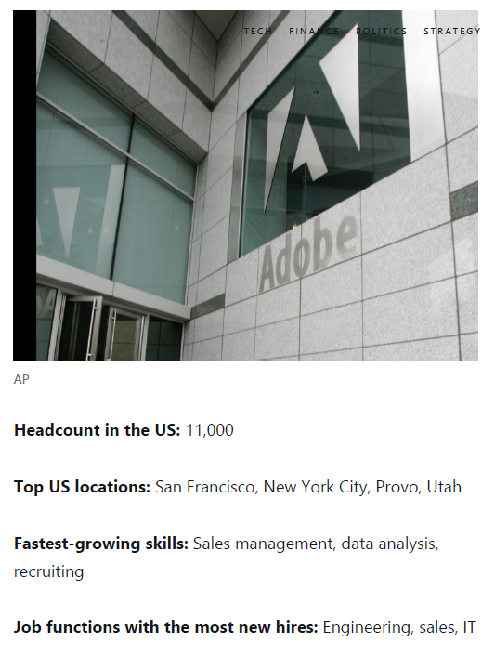

Slide 4
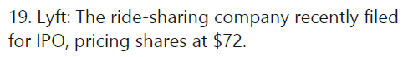
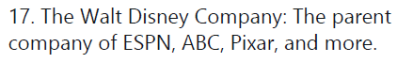
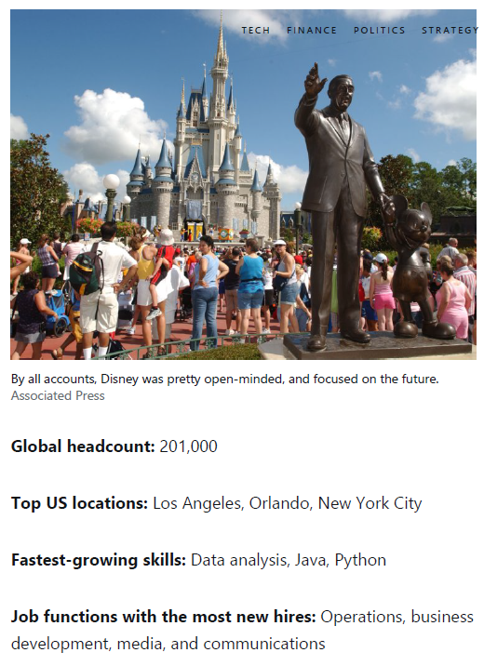
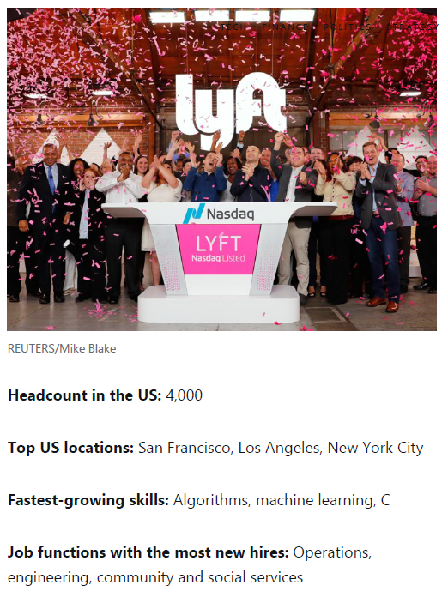

Slide 5
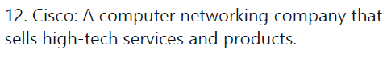
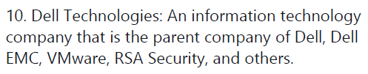
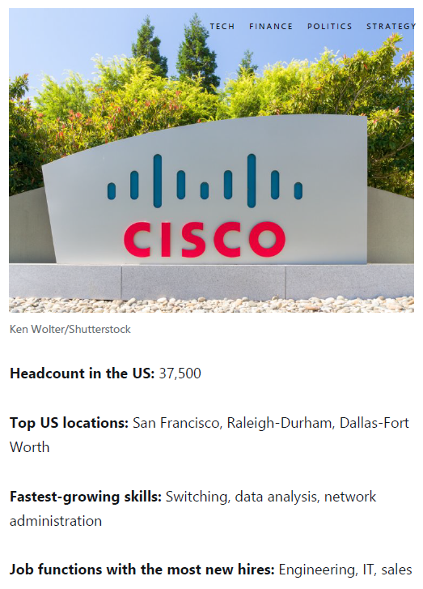
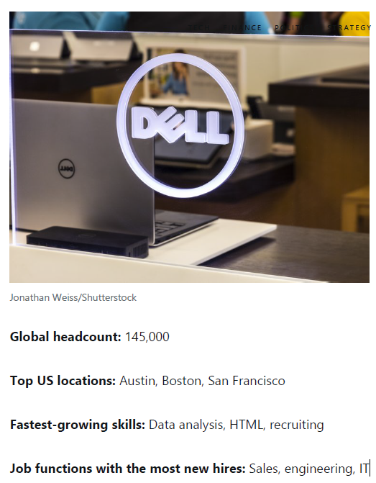

Slide 6
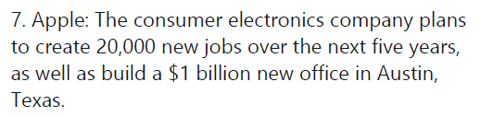
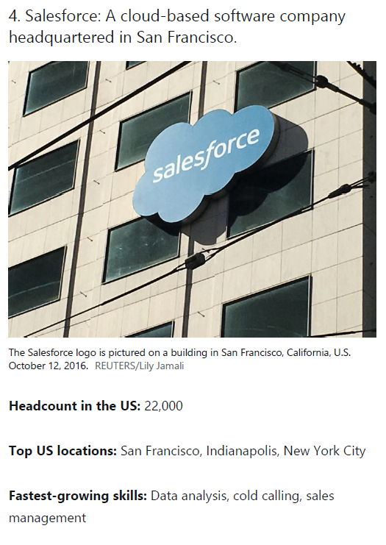
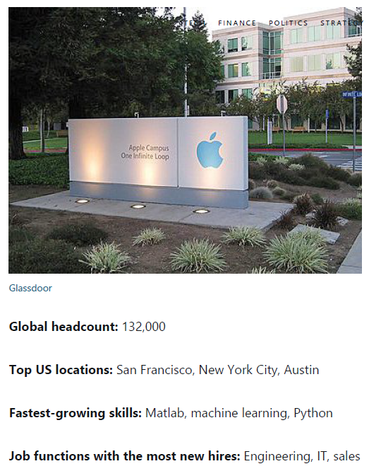

Slide 7
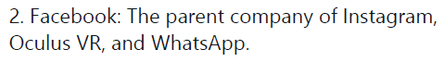
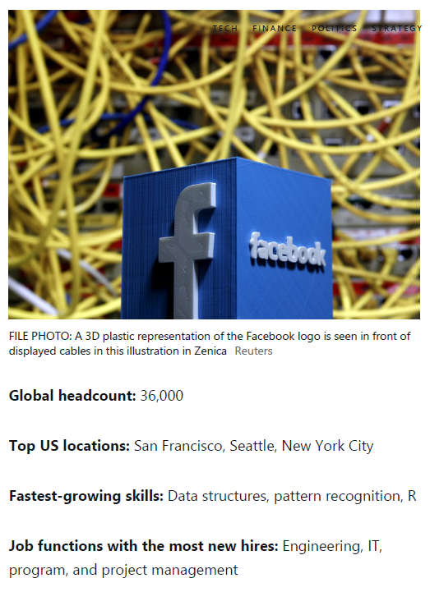

Slide 8

“Apple became the first U.S. company to surpass
$1 trillion in market value.”
- Wall Street Journal, August 2, 2018

Slide 9

Tech companies are amassing wealth and
power, creating a new order in business where the most valuable resource is no longer oil, but
data.
- Wall Street Journal, September 5, 2018

Slide 10
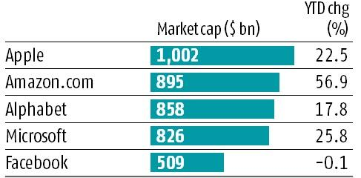
Top 5 Companies in the World

Slide 11
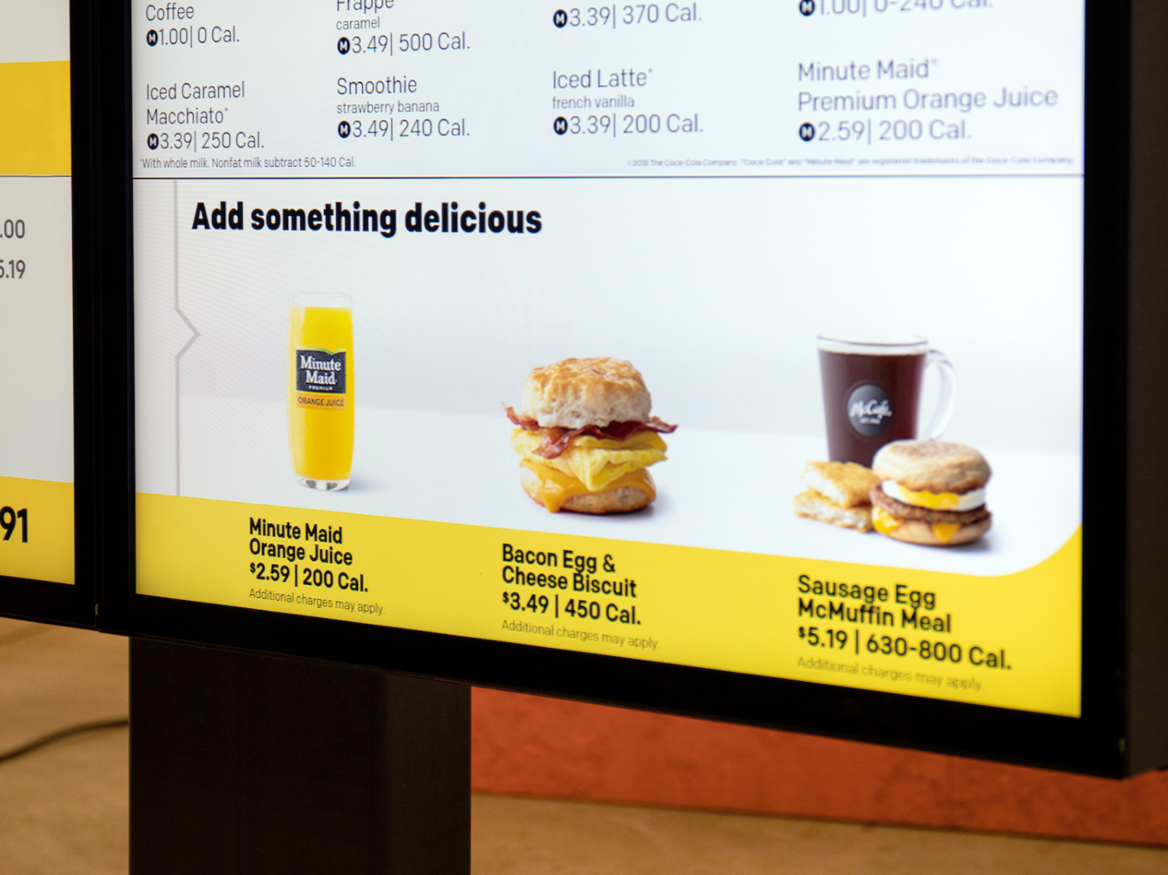
“We’re expanding our ability to increase the role technology and data will play in our future and create more personalized experiences for our customers.”
March 25, 2019
Steve Easterbrook, McDonald’s CEO

Slide 12
Doing Data Science

Slide 13
Start with Data

Slide 14
Start with Data
Collect

Slide 15
Start with Data
Collect
Correct

Slide 16
Start with Data
Collect
Correct
Know your domain

Slide 17
How will data science improve what we do?

Slide 18
How will data science improve what we do?
Leverage data to gain an advantage
Identifying key metrics to track and forecast
Building predictive models
Running experiments to test product/service changes
Building data products that enable new features or services

Slide 19
Some of the benefits of using data science for individuals are:
Better understand all of the data around you
Change your organization
Better engage with your passions

Slide 20
Start

Slide 21
Start
*Start small to have some success and then gain momentum.

